Slide 1
Tacit Programming
(or ‘point-free style’)

Slide 2
What is Tacit/Point-free Programming
A programming paradigm in which functions do not identify the arguments (or "points") on which they operate
Instead they compose other functions, and then apply the data only when the function is used

Slide 3
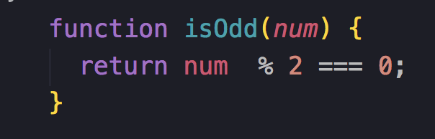
Consider:
How could we write isEven()?

Slide 4
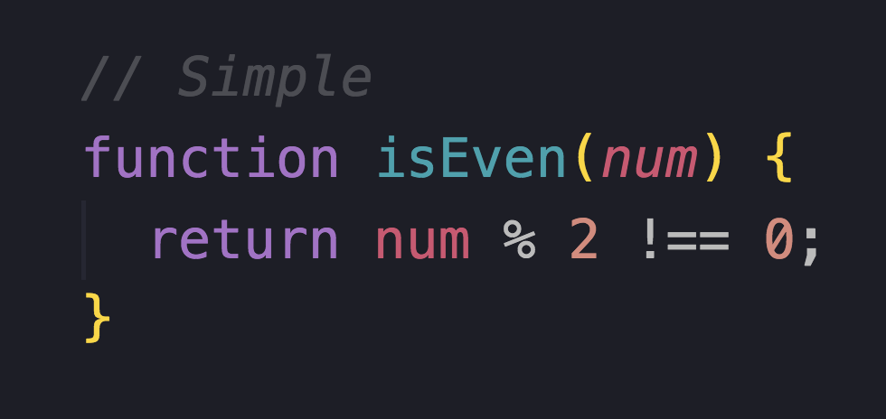
?

Slide 5
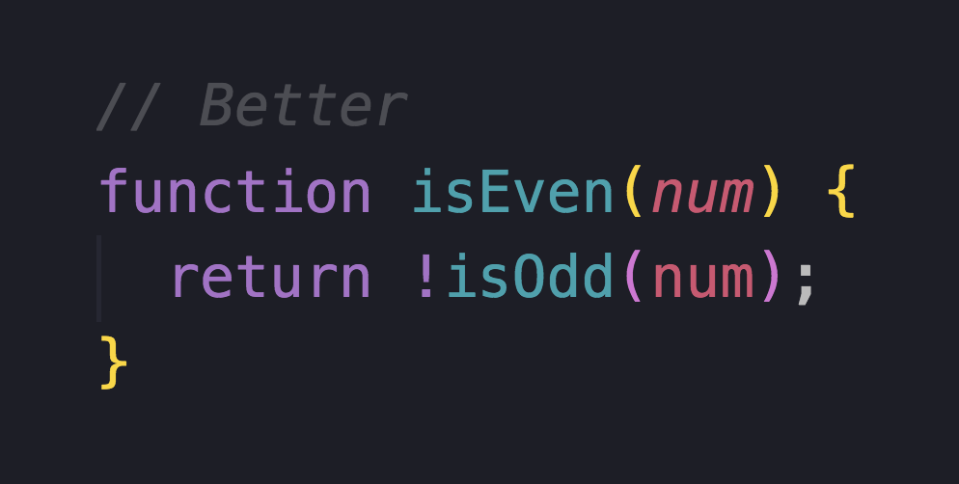
?

Slide 6
What is the intention?
We are inverting the function isOdd
Do we need a reference to the value isOdd to create this behavior?

Slide 7
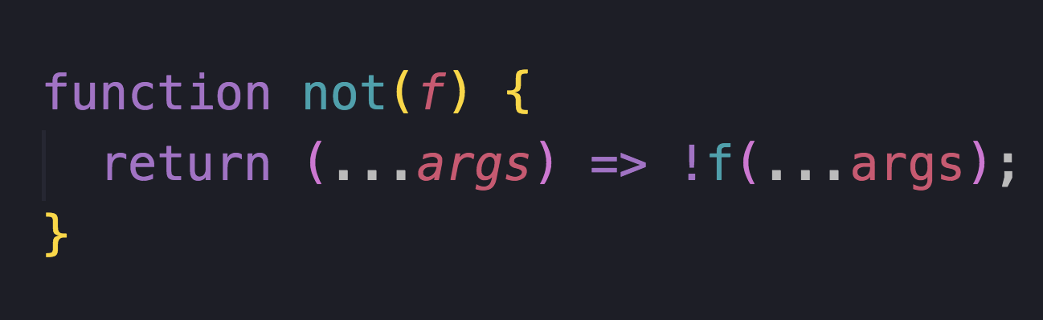
Not
Point free!

Slide 8
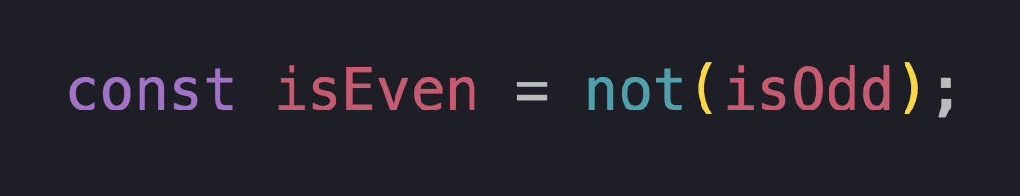
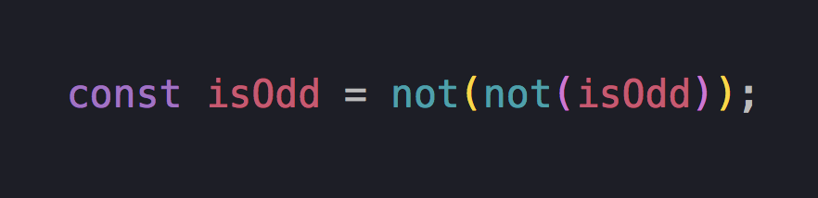

Slide 9
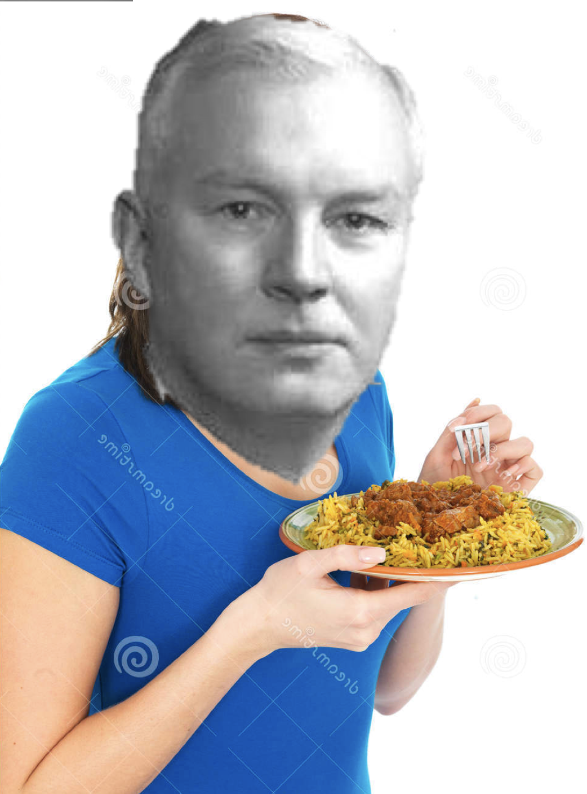
Currying
Invented by Haskell Curry
(He also invented Haskell)

Slide 10
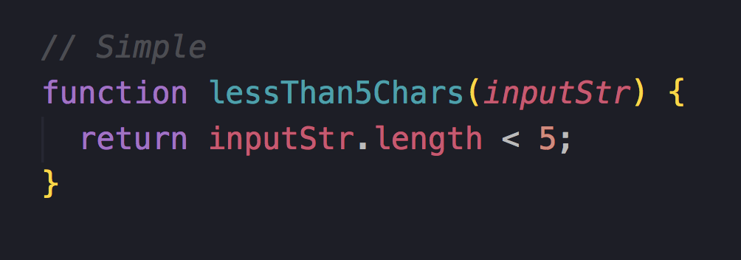
How can we make this point-free?

Slide 11
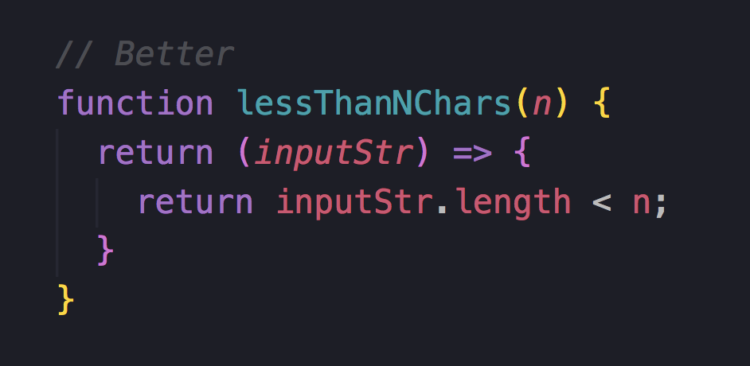
Curried
Curried functions go from f(a, b, c) -> f(a)(b)(c)

Slide 12
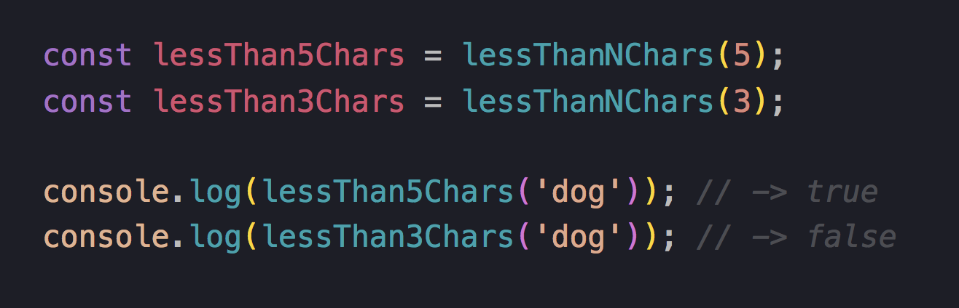
We can now apply the first argument & re-use the function

Slide 13
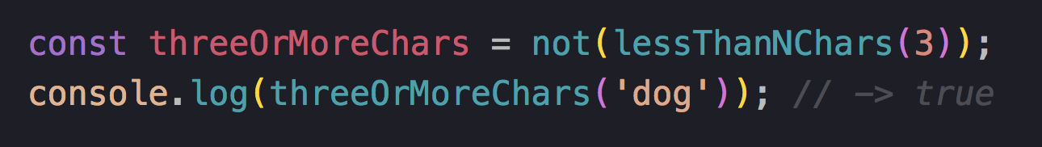

Combining these reads nicely:

Slide 14
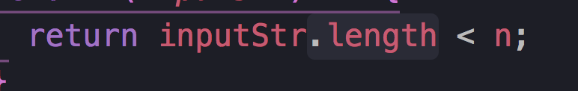
But it’s still not point free….

Slide 15
Composition

Slide 16
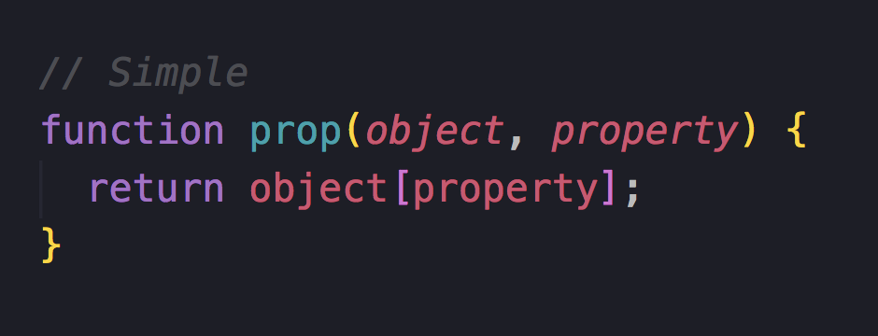

Slide 17
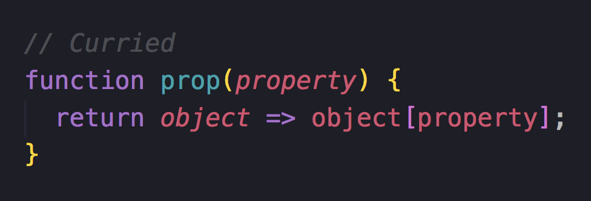
Let’s start by currying

Slide 18
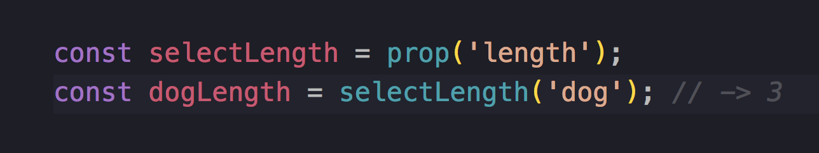


Slide 19
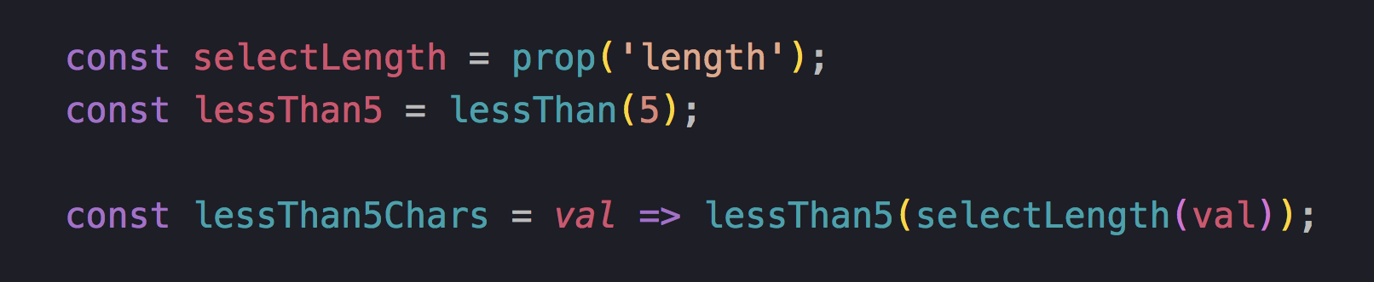
Point free!

Slide 20
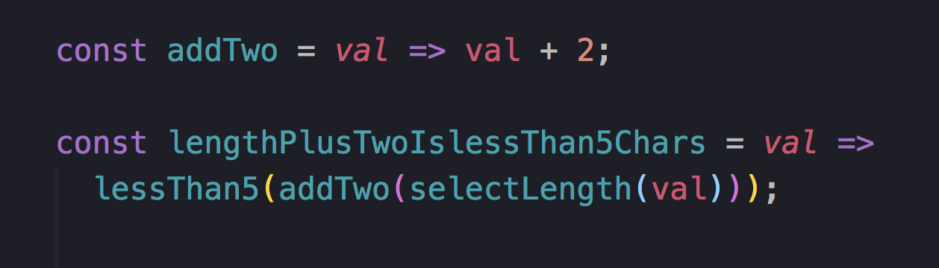
As we add functions this can get messy:

Slide 21
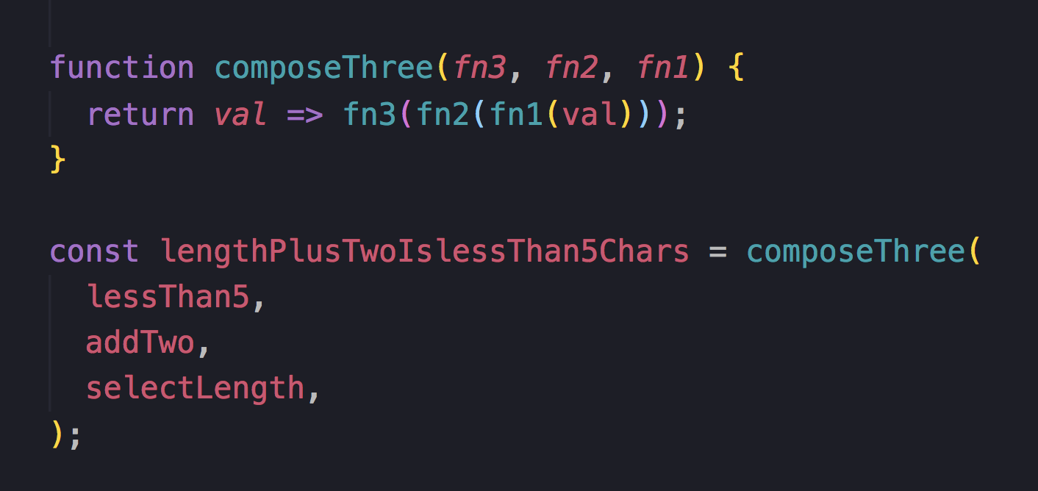
But we can compose them….

Slide 22
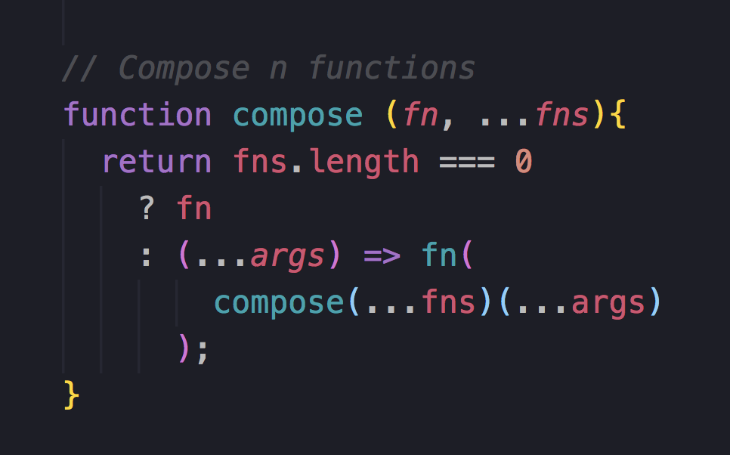
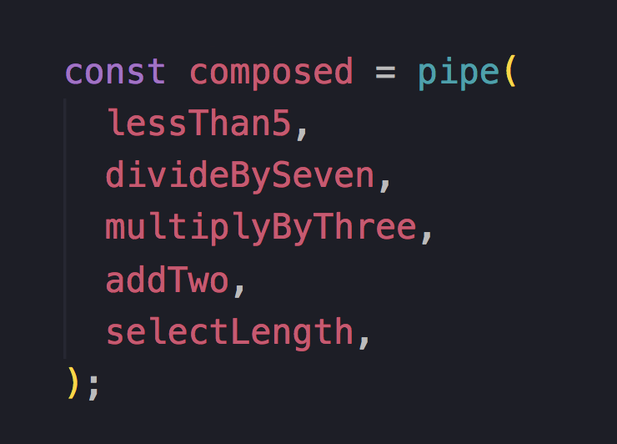
And compose n functions

Slide 23
Pipe
Compose’s less cool friend (apparently)

Slide 24
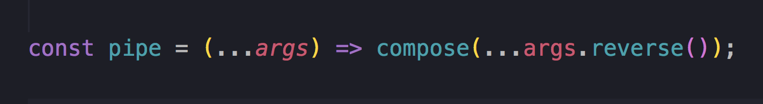

Slide 25
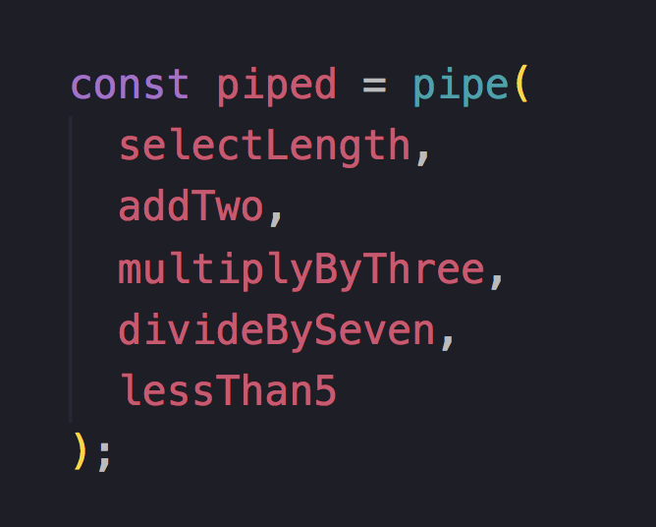
Pipe = Left-to-right
Compose = Left-to-right

Slide 26
What about the real world?
(It exists)

Slide 27
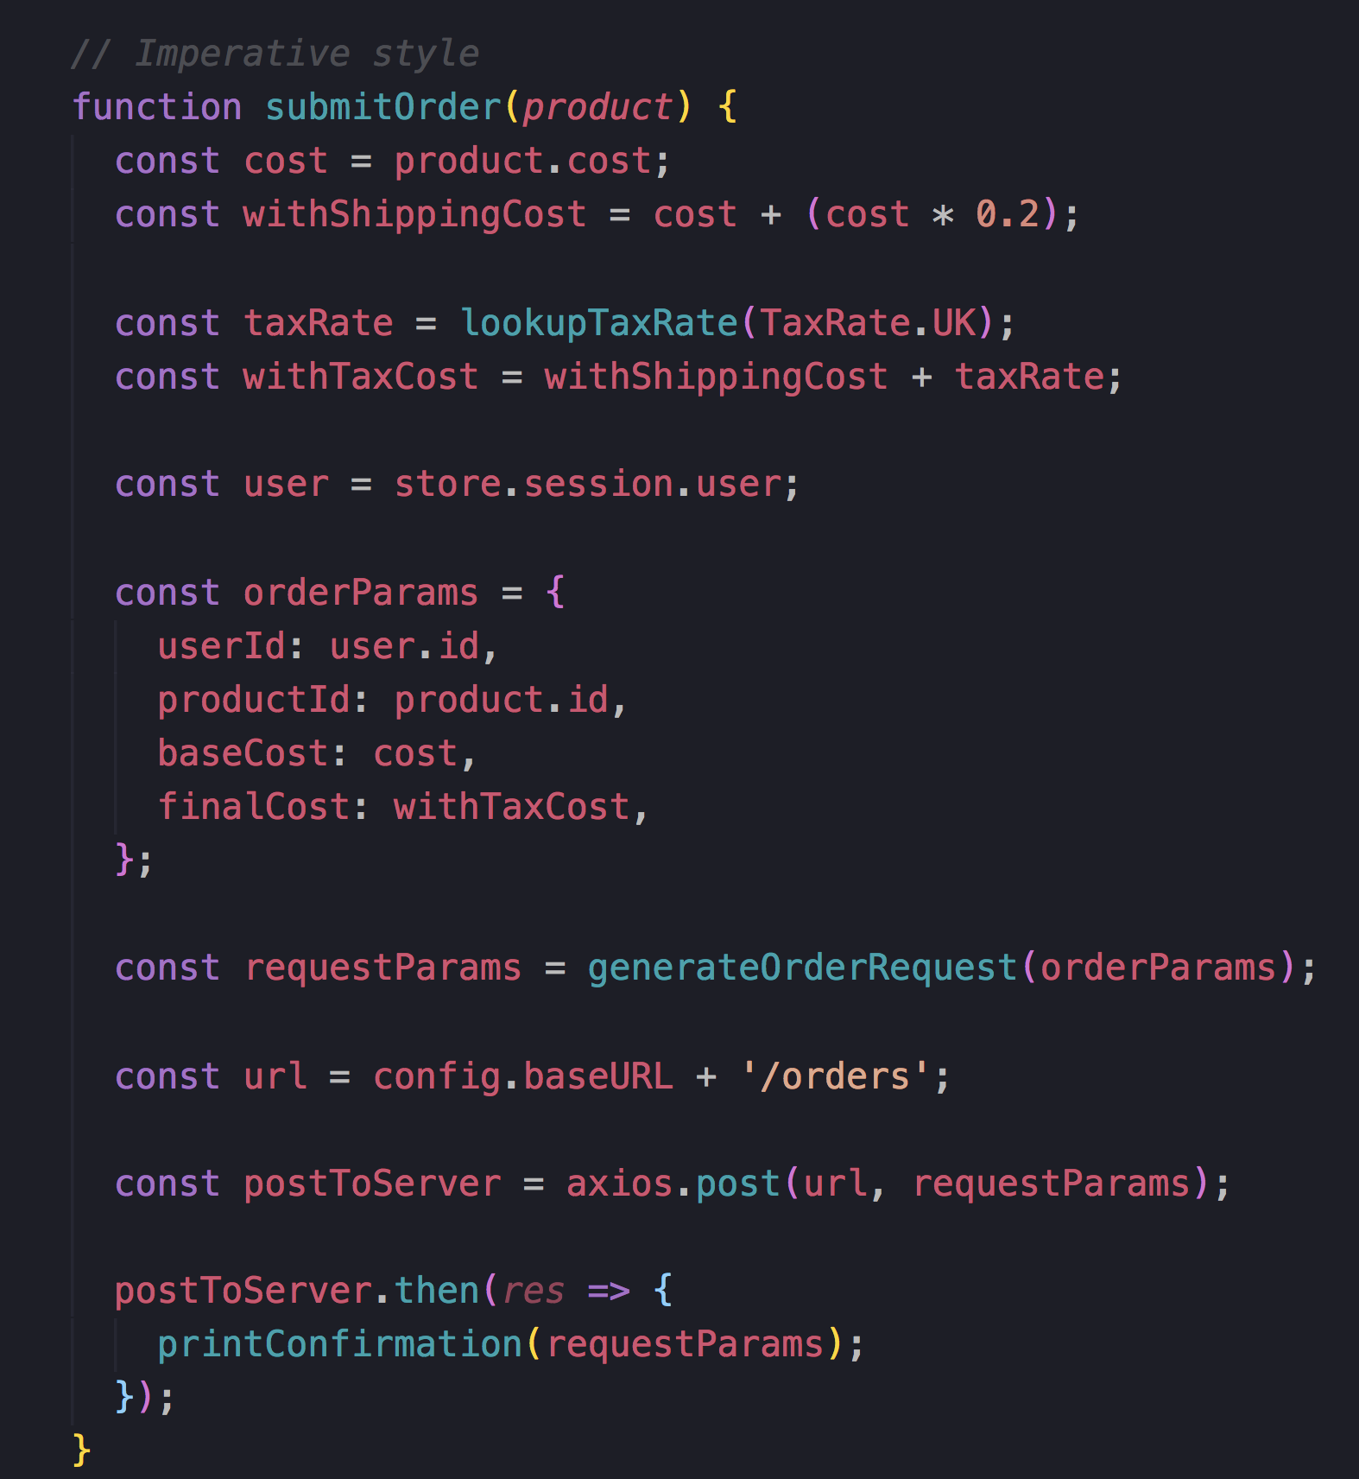


Slide 28
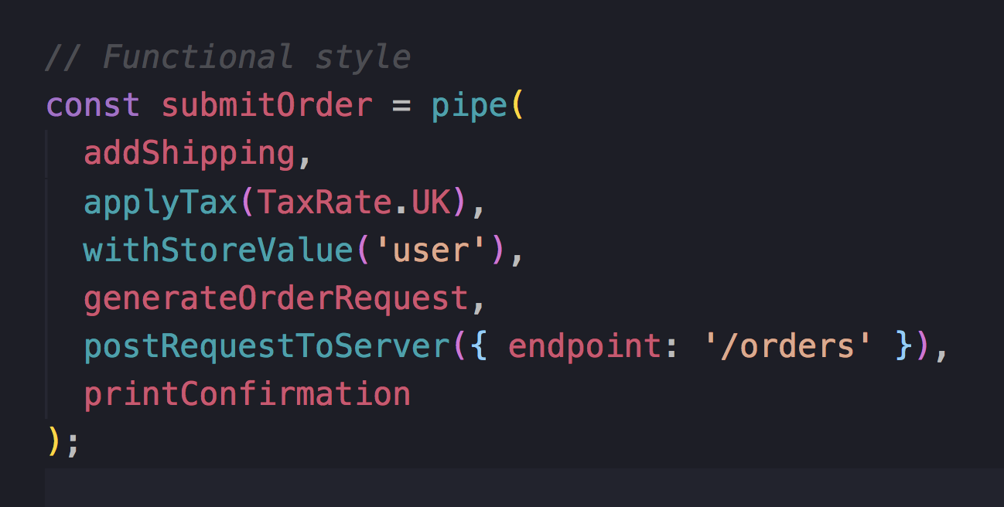
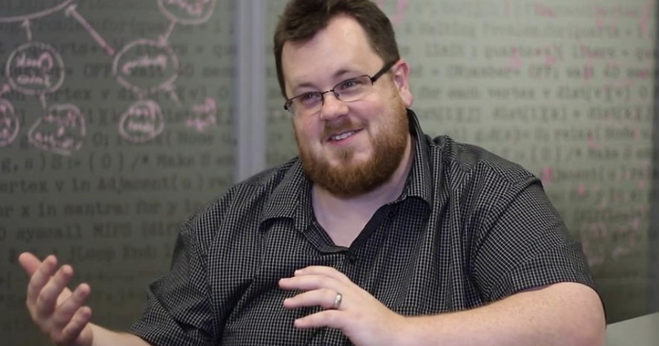
Each element re-usable
Test smaller chunks
Reads like english

Slide 29
In summary
Functions =

Slide 30
https://github.com/getify/Functional-Light-JS
Read it all for free ^

